Slide 1
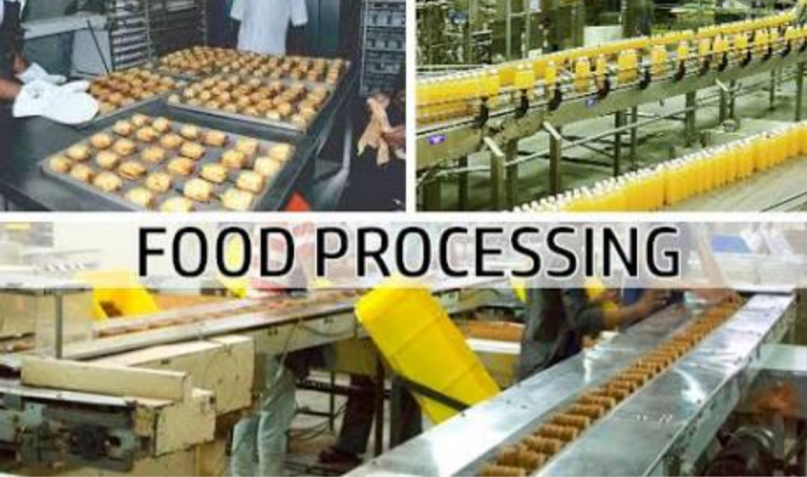
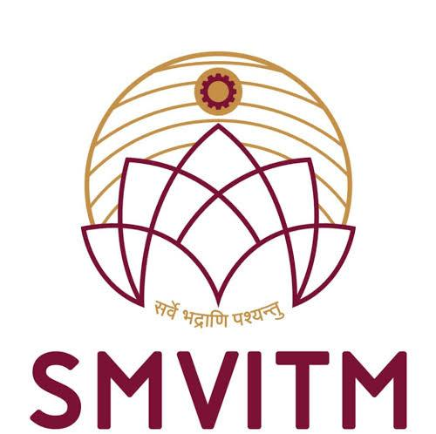
FOOD PROCESSING

Slide 2
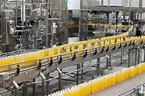
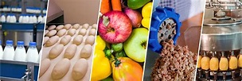
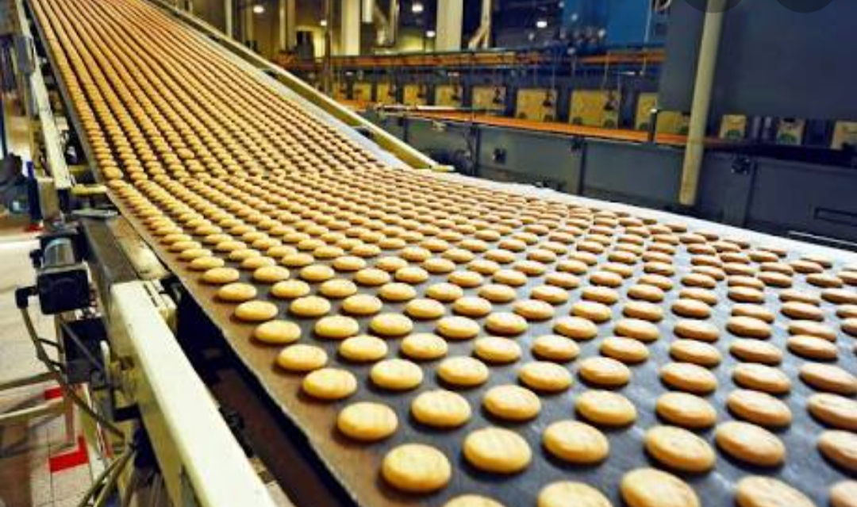
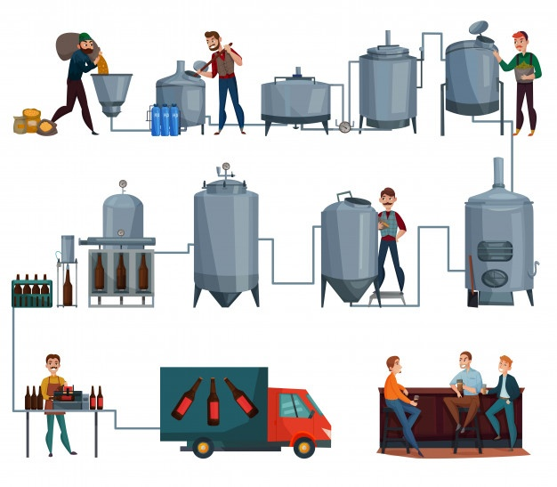

Slide 3
DEFINITION:-
Food processing Technology includes set of physical and chemical techniques in the transformation of food ingredients or agricultural products into food.
It includes many forms of processing foods, such as grinding grain to make raw flour to home cooking and complex industrial methods used to make convenience foods.

Slide 4
WHY PROCESS FOOD ?
EXTEND SHELF LIFE.
MAINTAIN SENSORY PROPERTIES.
MAINTAIN AND IMPROVE NUTRITUVE VALUES.
ENSURE SAFETY.
MAKE MORE CONVENIENT.
INCREASE THE ECONOMIC VALUE.

Slide 5
HEAT PROCESSING:Use of high temperature to destroy the enzymes that could lead to safety of food and better quality of food.
1) BLANCHING:- A mild heat treatment that primarily destroys the enzymes and reduces the microbial load,further preservation methods needed to extend shelf life.
Examples :-Boiling vegetables
2) PASTEURIZATION:-A mild heat treatment that primarily destroys pathogenic organisms but it also reduces microbial load. Requires additional preservation method to extend shelf life.
Examples :-Refrigeration ,Drying

Slide 6
3) COMMERCIAL STERILIZATION (Canning) :- A severe heat treatment that destroys pathogenic and many microorganisms that could spoil food,that extends shelf life. Ex:- canned foods 4) STERILIZATION:- A very severe heat treatment that destroys all microorganismsHydrogen peroxide, Nitrogen dioxide, Glutaraldehyde and formaldehyde solutions, Phthalaldehyde, and Peracetic acid are other examples of chemicals used for sterilization.

Slide 7
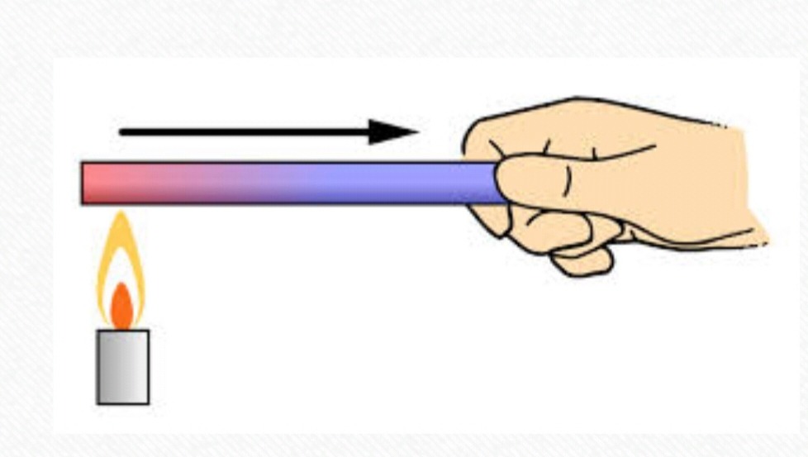
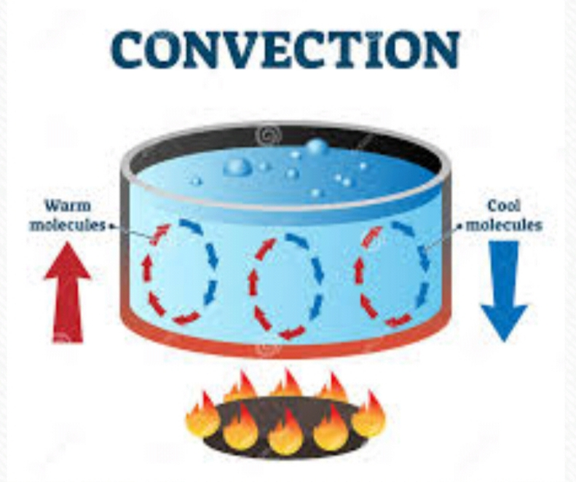
Methods of Heat Transfer Conduction :- Heating solids ; Slow hearing; Heating of fixed molecules in a row Ex: hot stove to a pot or pan,chocolate melting Convection :- Faster heating of liquids and gas ; hot liquids and gases raise ,cooler portions sink. Ex : Steam in tea, Ice melting

Slide 8
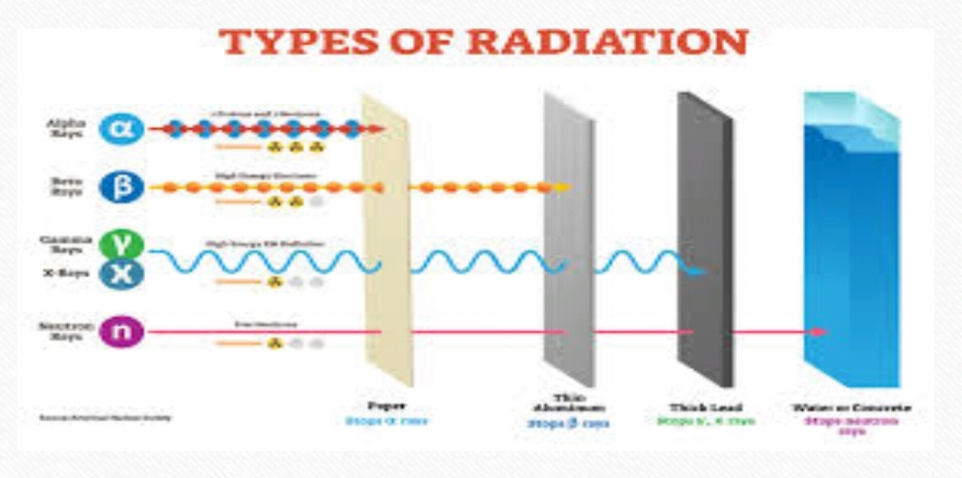
Radiation :- This is through Electromagnetic waves.It is different from conduction and convection as it requires no matter or medium to be present.The radioactive energy will pass perfectly through vacuum as well as clear air . Ex: UV lights from sun ,visible lights from candle,microwaves from microoven.

Slide 9
BLANCHING:- Blanching is a process of scalding vegetables in boiling water or steam for a short time . It stops enzyme actions which can cause loss of flavour ,color and texture.Balnching cleanses the surface of dirt and organisms,brightens the color and helps retard loss of vitamins Objectives:- 1) Inactive enzymes 2)lower microbial load 3)removes dirt leaves

Slide 10
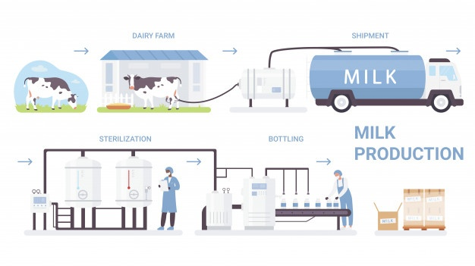
PASTEURIZATION:-Pasteurisation is food processing method where a mild heat treatment is applied to a food to kill harmful bacteria and extend shelf life.1) Used for milk , liquid eggs,fruit juices and beer. 2) destroy pathogens 3) reduce microbial growth n extend shelf life Types :- Milk,Egg ,Fruit pasteur,Beer pasteurisation.

Slide 11
CANNING:- Comes under commercial sterile product.Canning is process of use of heat and absence of oxygen to prevent the spoilage foods. Methods:- 1) Still retort 2)Agitation 3) Aseptic 4) Ohmic 5) pressure 6)Sous vide( under vacuum) 7)Microwave

Slide 12
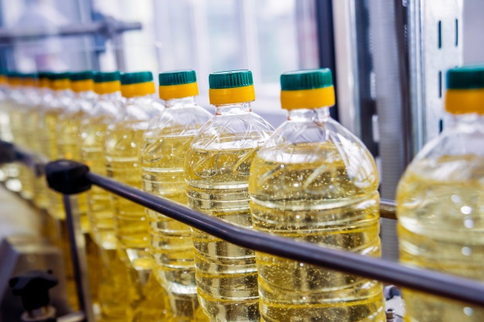
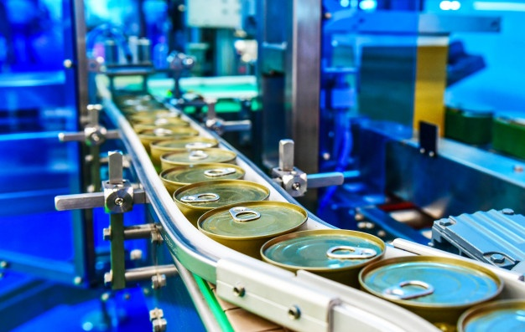
PACKAGING:- Packing foods for further transportation or storing purpose. Packaging can be made through these things:- 1) Metal : Tin /Iron / Tin cans. Or Aluminium 2) Glass 3) plastic /Metal/ Fiber flexible pouches Over all quality of Canned food :- 1) Protein:- it can be improved or impaired 2)Fats:- Oxidative rancidity can be increased if oxygen not properly removed from cans 3) Carbohydrates:-Non enzymatic browning increases 4)Vitamins:- Some water soluble vitamins lost. ex :-Thiamin,Vitamin C

Slide 13
Preservation of foods by lowering temperature 1) Refrigeration:- Here temperature typically between 45- 32 °F (7.2 - 0℃)Prefer below 38°F Lower temperature will reduce spoilage 2) Freezing :-Temperature is <32°F (0℃) Change in liquid form to solid In the case of refrigeration, the idea is to slow bacterial action to a crawl so that it takes food much longer (perhaps a week or two, rather than half a day) to spoil. ... In the case of freezing, the idea is to stop bacterial action altogether. Frozen bacteria are completely inactive.erence btwn Refrigeration and Freezing:

Slide 14
DRYING:- Process of removal of water or another solvent by a evaporation from a solid,semi solid or liquid. This process is often used as final production step before selling or packaging products. Drying is the oldest form of food preservation Most widely used preservative method Types: 1)Sun drying: drying seeds 2)Hot air drying:to dry some fruits or vegetables 3)Drum drying: for potato pastes ,slurries 4)Spray drying:used only for liquid like milk,Coffee 5)Puff drying 6) Freeze drying 7)Hot oil 8) Chemical drying 9) Smoking

Slide 15
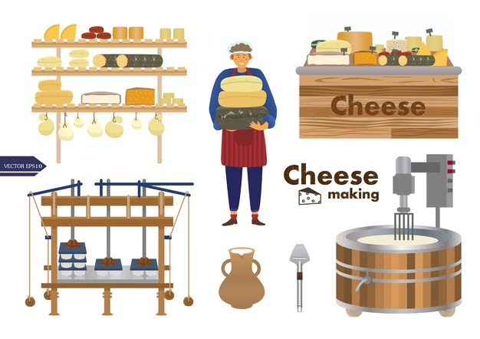
FERMENTATION:-Use of microorganisms to convert foods into a more stable form.Typically conversion of carbohydrates into acid or alcohol. Note:- Reduce the pH(acidic medium)of the food or produce substances which make the environment uninhabitable by other organisms. Factors influence fermentation:- 1) Types of organisms 5)pH 2) Source of energy 6)Aw 3)Oxygen availability 4) Temperature Ex:- Cheese,Yogurt,Wine beer,Pickles,Vinegar,Soy sauce.

Slide 16
FOOD PROCESSING TECHNOLOGIES

Slide 17
Introduction:- Indias diverse agro- climatic conditions allows production of many fruits and vegetables.
5252% cultivable land compared to 11% world avg.
All 15 major climates in the world exists in India
46 out of 60 soil types exists in India
20 agri- climate regions

Slide 18
Emerging Food processing Technologies 1)Ohmic heating 2) Microwave heating 3) Pulsed electric field 4)Pulsed light technology 5)High pressure processing 6) Ultrasound

Slide 19
Why we have to use these technologies? × Maintains nutritional quality of product by processing at mild temperature. × Do not emits combustion gases in atmosphere. × Shorter processing time × Automatic control × Uniform heating

Slide 20
Ohmic Heating:- × Advanced thermal processing method. × Developed by United Kingdom Electrical Research Development center. × Licensed to APV baker Ltd. for commercial exploitation. × Also called Electrical resistance heating, Joule heating,or electro heating. × Food material is heated by passing electric current through it × Electric resistance of the food causes power to be translated directly into heat. × Electrical energy dissipated into heat, which results in rapid and uniform heating.

Slide 21
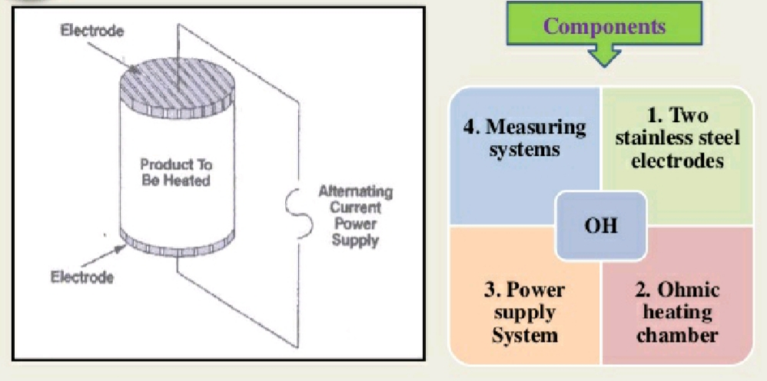
Applications:- Rice bran stabilization, Blanching, Sterilisation,Juice extraction,Oil extraction, Pasteurization, Evaporation, Dehydration, Fermentation,peeling etc

Slide 22
Advantages and Limitations of Ohmic heating
ADVANTAGES
High energy efficiency because 90% electrical energy converted into heat.
Reducing risks of burning of food product.
Suitable for continues operation.
Uniform heating of particulars food with faster heating rates.
Easy to operate and no residual heat transfer after the current is shut off
Environment friendly system.
LIMITATIONS
Only suitable for liquid or particles in liquid.
Lack of generalized information
Narrow frequency band
Requested adjustment according to conductivity of dairy liquid.

Slide 23
Microwave heating:- × It uses electromagnetic waves of frequencies (3MHz to 300GHz). × Polar water molecules will rotate according to the alternating electromagnetic field. × Water molecule is 'Dipole' × Dipoles will orient themselves when they subjected to em waves × Rotate about 24 billions times per second × Ionic compounds can also be accelerated by electromagnetic field. × This orientation of water molecules cause huge friction inside the product and hence generation of heat take place inside the product.

Slide 24
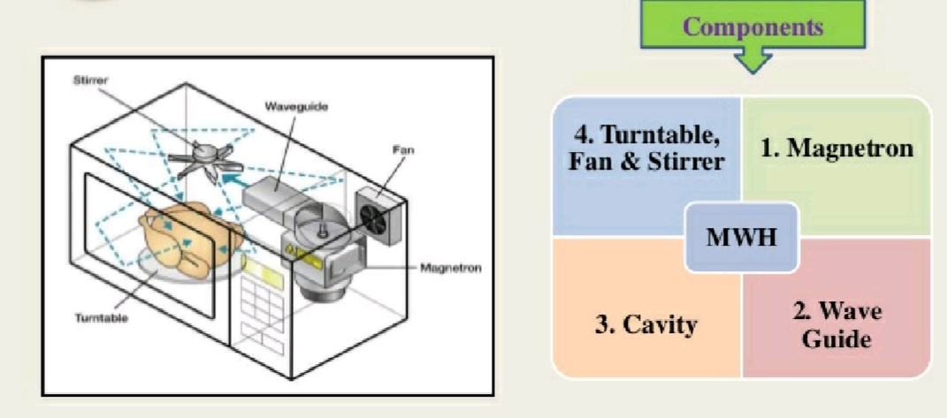
Applications:- Pasteurization, Sterilization, dehydration, baking, cooking, boiling

Slide 25
Advantages and Limitations of Microwave heating
Advantages
Rapid and uniform heating
High heating efficiency (abive 80% can be achieved)
Equipment is small, compact, clean in operation.
Surface of the food does not over heat
Automatic process control
Limitations
High initial cost
Non uniform heating when using large size product
Less energy efficient than ohmic heating

Slide 26
Pulsed Electric Field:- × Also called as High Intensity Pulsed Electric Field × Mainly used to inactivate deteriorative microorganisms × Pulses of high voltage ( 20-80kV/cm) passed over the product placed between electrodes for an extremely short period of time (1-100us). × The gap between two electrodes is called as the treatment gap.

Slide 27
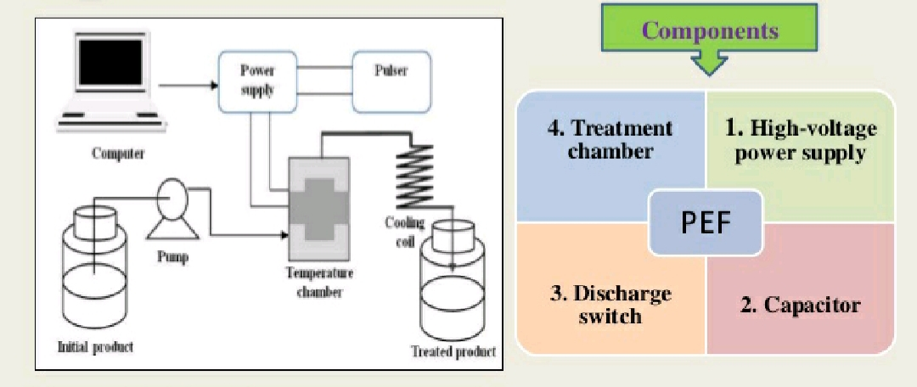
Applications:- × Used for preservation of pumpable fluid or semi fluid food
Pasteurization of fruit juices, soups,milk.

Slide 28
Advantages and Limitations of Pulsed electric field
Advantages
Kills vegetative cells
Colors, flavours, nutrients are preserved
No evidence of toxicity
Relatively short treatment time
Limitations
Only suitable for liquids or particles in liquids
Only effective in combination of heat
Energy efficiency not yet certain

Slide 29
Pulsed light Technology:- × Also called as High Intensity Light × Contains a broad spectrum of'White' light ,from UV wavelength of 200nm to NIR wavelength of 1000nm × Peak emissions between 400 -500nm × Emit 1-20 flashes per second of electromagnetic energy × The antimicrobial effects of IV wavelengths are due to absorption of the energy by highly conjugated double carbon bonds and nuceic acid × Which leads to structural changes in the DNA, as well as ion flow, increased cell membrane permeability and depolarization of cell membrane

Slide 30
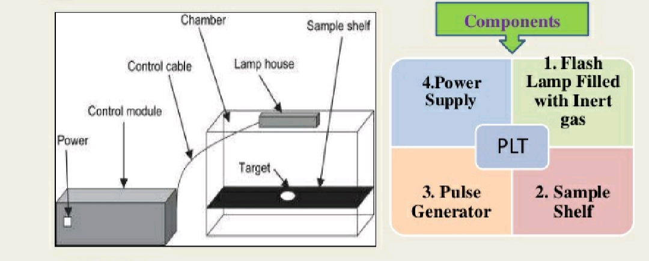
Applications:-Used in decontamination of vegetables, fruits, baked products
Microbial inactivation of water, and sanitation of packaging materials.

Slide 31
Advantages and Limitations of Pulsed light Technology
Advantages:-
Medium cost
Very rapid process
Little or no changes to foods
Suitable for dry food
Limitations:-
Difficult to use with complex surfaces
Not prooven effective against spores

Slide 32
High pressure Processing:- ×Also called as High hydrostatic pressure processing × High pressure up to 1000Mpa are applied to food packages submerged in a liquid × Pressure causes destruction of microorganisms × High pressure is applied in an isostatic manner such that all regions of the food experience a uniform pressure.

Slide 33
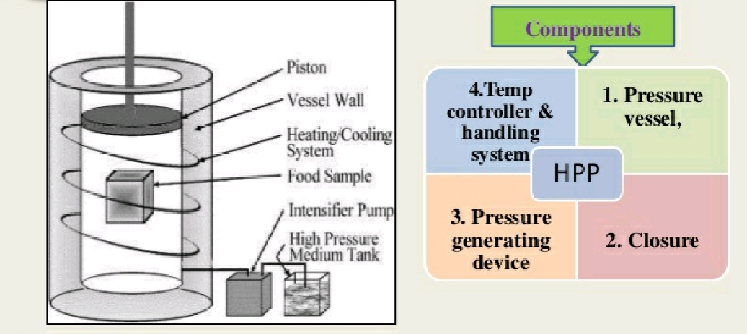
Applications:- Pasteurization and sterilization of fruits, fruit product, sauces, pickles, yogurt and vegetables

Slide 34
Ultrasound:- ×Also called as Ultrasonication × The freq.of sound waves audible to human ear ranges from 20Hz to 20 kHz. Ferq.below 20Hz are Infrasound and above 20 kHz are ultrasound. × When ultrasound waves meet medium,it creates regions of alternating compression and expansion. × These compression and expansion cause formation of bubbles in the medium that is cavitations. × These bubbles are larger in size during expansion cycle, which iincreases gas diffusion, causing the bubble to expand × when ultrasonic energy is insufficient to retain the vapour phase in the bubbles then rapid condensation occurs. × The condensed molecules collide and create shock waves which create regions high temperature and pressure

Slide 35
Types of ultrasounds:- × Low energy ultrasounds:- Frequencies >100kHz,low power and low intensity. And it is non-destructive, provide information such as physiochemical properties of food. ×High energy ultrasounds:- Frequencies between 18 to 100kHz high power and high intensity And used for physical disruption and chemical reaction

Slide 36
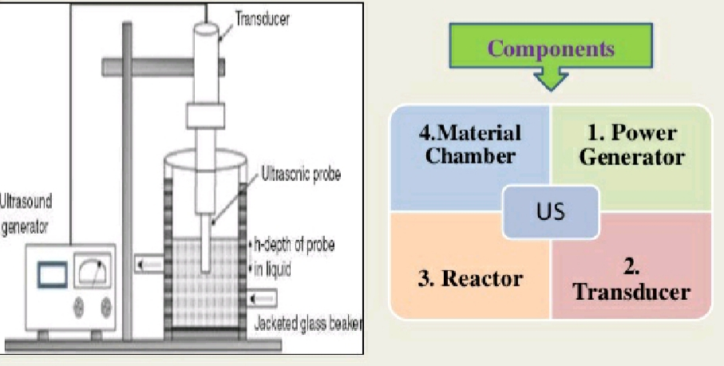
Applications:- Used for crystalization, foams destruction, filtration, drying, freezing,mixing, homogenization, growth modification in living cells, alteration of enzymes activity.

Slide 37
THANK YOU

